Slide 1
Support Vector Machines
Andrew W. Moore
Professor
School of Computer Science
Carnegie Mellon University
www.cs.cmu.edu/~awm
awm@cs.cmu.edu
412-268-7599
Note to other teachers and users of these slides. Andrew would be delighted if you found this source material useful in giving your own lectures. Feel free to use these slides verbatim, or to modify them to fit your own needs. PowerPoint originals are available. If you make use of a significant portion of these slides in your own lecture, please include this message, or the following link to the source repository of Andrew’s tutorials: http://www.cs.cmu.edu/~awm/tutorials . Comments and corrections gratefully received.
Slides Modified for Comp537, Spring, 2006, HKUST

Slide 2
Roadmap
Hard-Margin Linear Classifier
  Maximize Margin
  Support Vector
  Quadratic Programming
Soft-Margin Linear Classifier
  Maximize Margin
  Support Vector
  Quadratic Programming
Non-Linear Separable Problem
  XOR
Transform to Non-Linear by Kernels
Reference

Slide 3
Linear Classifiers
α
x
f
y^{est}
f(x,w,b) = sign(w. x - b)
denotes +1
denotes -1
How would you classify this data?

Slide 4
Linear Classifiers
α
x
f
y^{est}
f(x,w,b) = sign(w. x - b)
denotes +1
denotes -1
How would you classify this data?

Slide 5
Linear Classifiers
α
x
f
y^{est}
f(x,w,b) = sign(w. x - b)
denotes +1
denotes -1
How would you classify this data?

Slide 6
Linear Classifiers
α
x
f
y^{est}
f(x,w,b) = sign(w. x - b)
denotes +1
denotes -1
How would you classify this data?

Slide 7
Linear Classifiers
α
x
f
y^{est}
f(x,w,b) = sign(w. x - b)
denotes +1
denotes -1
Any of these would be fine..
..but which is best?

Slide 8
Classifier Margin
α
x
f
y^{est}
f(x,w,b) = sign(w. x - b)
denotes +1
denotes -1
Define the margin of a linear classifier as the width that the boundary could be increased by before hitting a datapoint.

Slide 9
Maximum Margin
α
x
f
y^{est}
f(x,w,b) = sign(w. x - b)
denotes +1
denotes -1
The maximum margin linear classifier is the linear classifier with the, um, maximum margin.
This is the simplest kind of SVM (Called an LSVM)
Linear SVM

Slide 10
Maximum Margin
α
x
f
y^{est}
f(x,w,b) = sign(w. x - b)
denotes +1
denotes -1
The maximum margin linear classifier is the linear classifier with the, um, maximum margin.
This is the simplest kind of SVM (Called an LSVM)
Support Vectors are those datapoints that the margin pushes up against
Linear SVM

Slide 11
Why Maximum Margin?
Intuitively this feels safest.
Empirically it works very well.
If we’ve made a small error in the location of the boundary (it’s been jolted in its perpendicular direction) this gives us least chance of causing a misclassification.
LOOCV is easy since the model is immune to removal of any non-support-vector datapoints.
There’s some theory (using VC dimension) that is related to (but not the same as) the proposition that this is a good thing.
f(x,w,b) = sign(w. x - b)
denotes +1
denotes -1
The maximum margin linear classifier is the linear classifier with the, um, maximum margin.
This is the simplest kind of SVM (Called an LSVM)
Support Vectors are those datapoints that the margin pushes up against

Slide 12
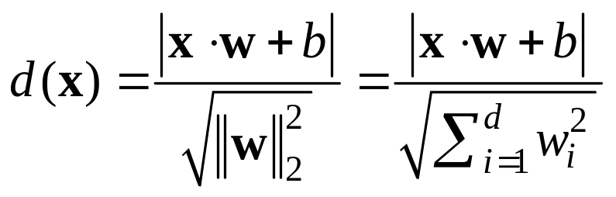
Estimate the Margin
denotes +1
denotes -1
wx +b = 0
x
X – Vector
W – Normal Vector
b – Scale Value
W
What is the distance expression for a point x to a line wx+b= 0?

Slide 13
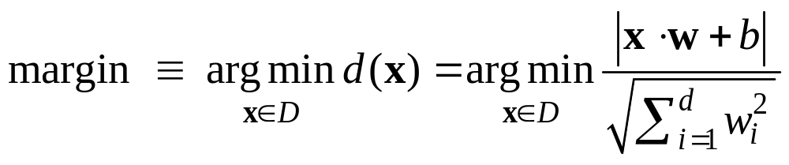
Estimate the Margin
denotes +1
denotes -1
wx +b = 0
Margin
What is the expression for margin?

Slide 14
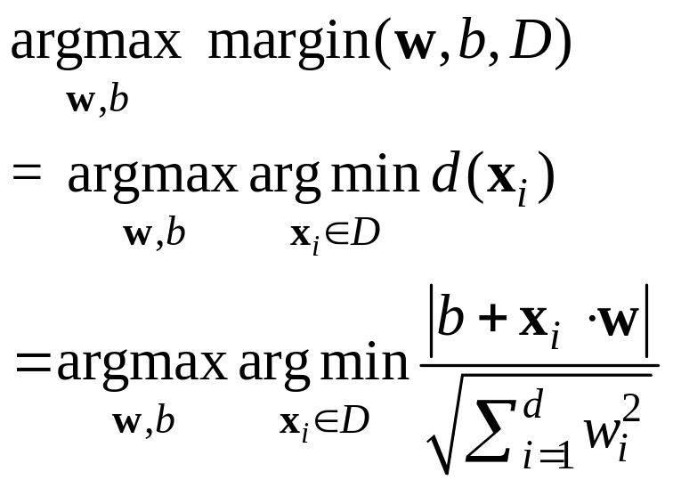
Maximize Margin
denotes +1
denotes -1
wx +b = 0
Margin

Slide 15
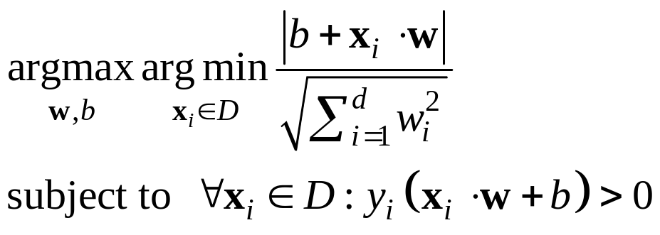
Maximize Margin
denotes +1
denotes -1
wx +b = 0
WX_{i}+b≥0 iff y_{i}=1
WX_{i}+b≤0 iff y_{i}=-1
Margin
yi(WX_{i}+b) ≥0
≥0
Min-max problem → game problem

Slide 16

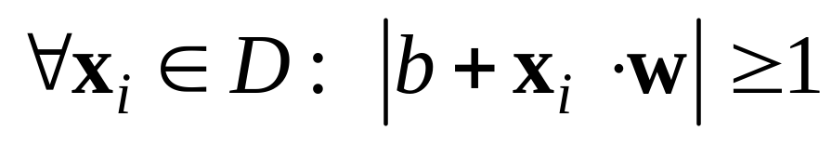
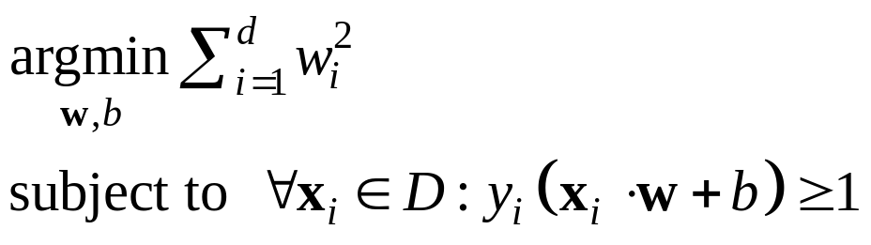
Maximize Margin
WX_{i}+b≥0 iff y_{i}=1
WX_{i}+b≤0 iff y_{i}=-1
denotes +1
denotes -1
wx +b = 0
yi(WX_{i}+b) ≥ 0
Margin
Strategy:
wx +b = 0
α(wx +b) = 0 where α≠0

Slide 17
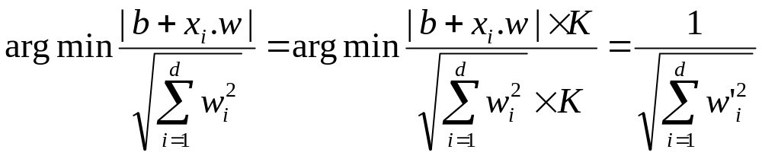
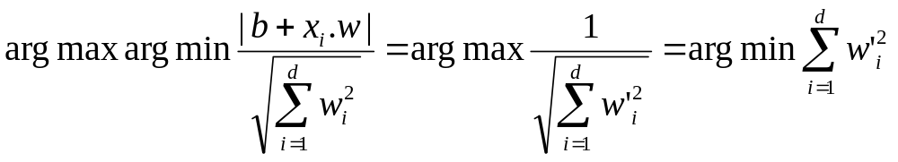
Maximize Margin
How does it come ?
We have
Thus,

Slide 18
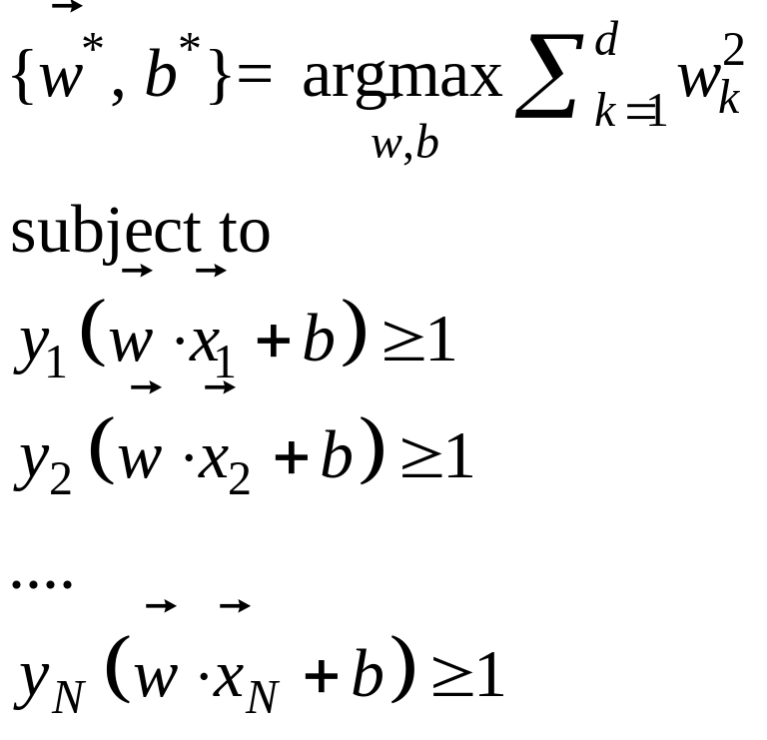
Maximum Margin Linear Classifier
How to solve it?

Slide 19
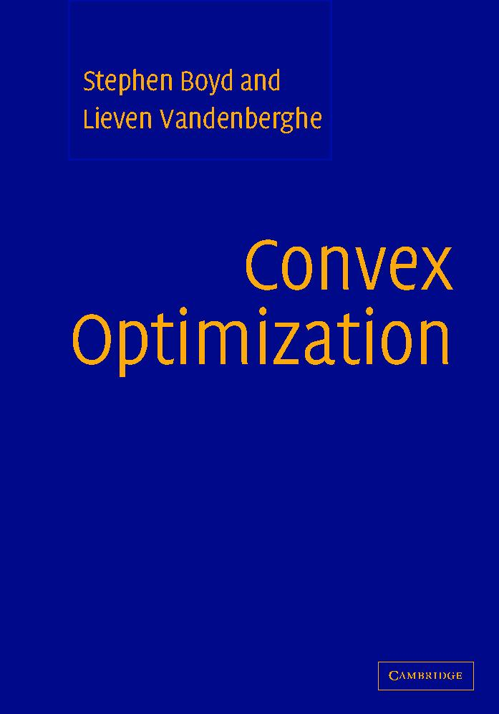
Learning via Quadratic Programming
QP is a well-studied class of optimization algorithms to maximize a quadratic function of some real-valued variables subject to linear constraints.
Detail solution of Quadratic Programming
  Convex Optimization Stephen P. Boyd
  Online Edition, Free for Downloading

Slide 20
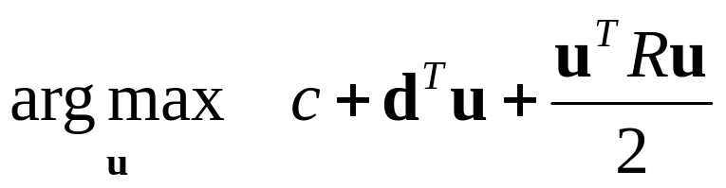
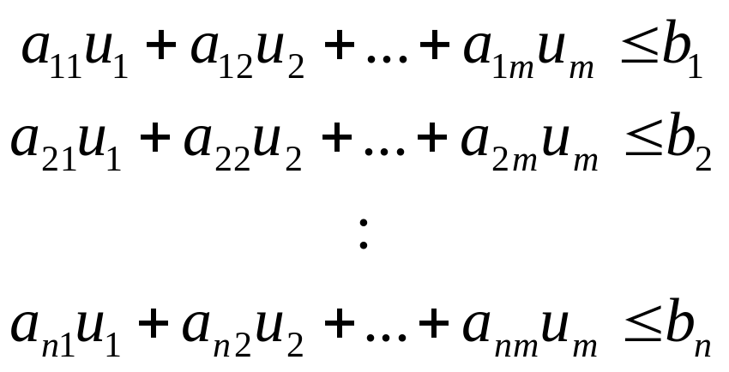
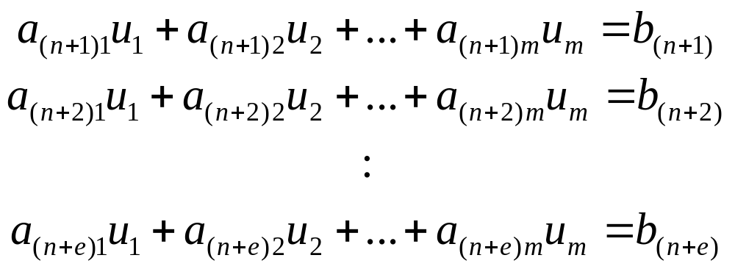
Quadratic Programming
Find
Quadratic criterion
Subject to
n additional linear inequality constraints
And subject to
e additional linear equality constraints

Slide 21
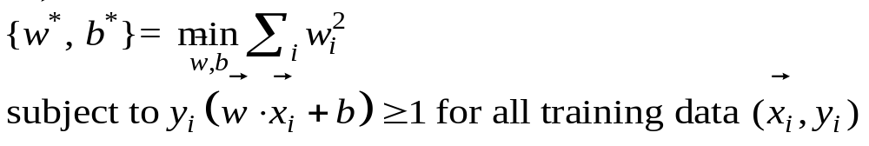
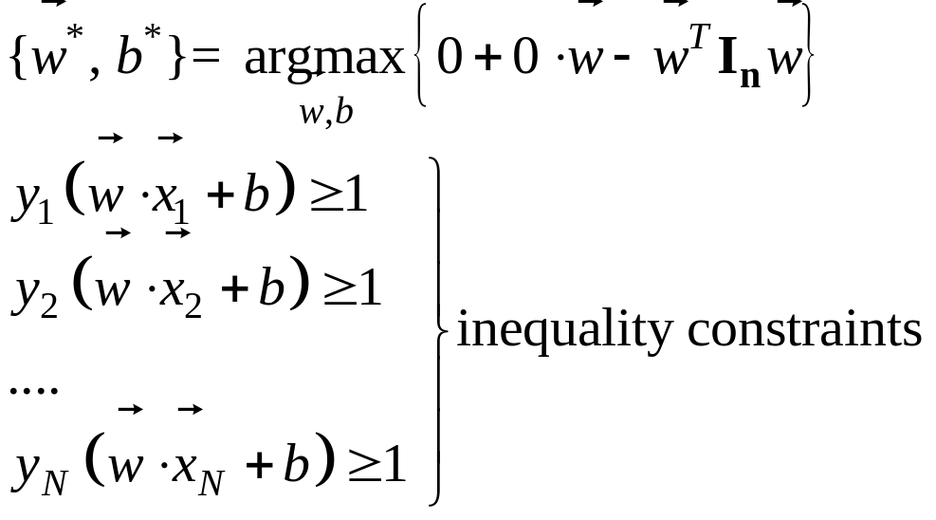
Quadratic Programming for the Linear Classifier

Slide 22
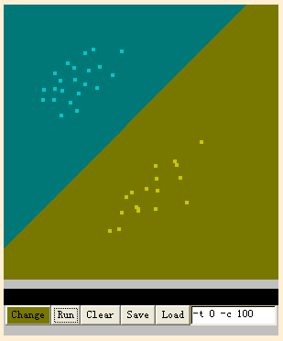
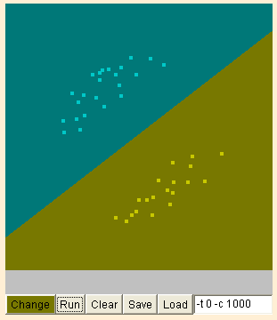
Online Demo
Popular Tools - LibSVM

Slide 23
Roadmap
Hard-Margin Linear Classifier
  Maximize Margin
  Support Vector
  Quadratic Programming
Soft-Margin Linear Classifier
  Maximize Margin
  Support Vector
  Quadratic Programming
Non-Linear Separable Problem
  XOR
Transform to Non-Linear by Kernels
Reference

Slide 24
Uh-oh!
This is going to be a problem!
What should we do?
denotes +1
denotes -1

Slide 25
Uh-oh!
This is going to be a problem!
What should we do?
Idea 1:
  Find minimum w.w, while minimizing number of training set errors.
    Problemette: Two things to minimize makes for an ill-defined optimization
denotes +1
denotes -1

Slide 26
Uh-oh!
This is going to be a problem!
What should we do?
Idea 1.1:
  Minimize
  w.w + C (#train errors)
There’s a serious practical problem that’s about to make us reject this approach. Can you guess what it is?
denotes +1
denotes -1
Tradeoff parameter

Slide 27
Uh-oh!
This is going to be a problem!
What should we do?
Idea 1.1:
  Minimize
  w.w + C (#train errors)
There’s a serious practical problem that’s about to make us reject this approach. Can you guess what it is?
denotes +1
denotes -1
Tradeoff parameter
Can’t be expressed as a Quadratic Programming problem.
Solving it may be too slow.
(Also, doesn’t distinguish between disastrous errors and near misses)
So… any other ideas?

Slide 28
Uh-oh!
This is going to be a problem!
What should we do?
Idea 2.0:
  Minimize
  w.w + C (distance of error
  points to their
  correct place)
denotes +1
denotes -1

Slide 29
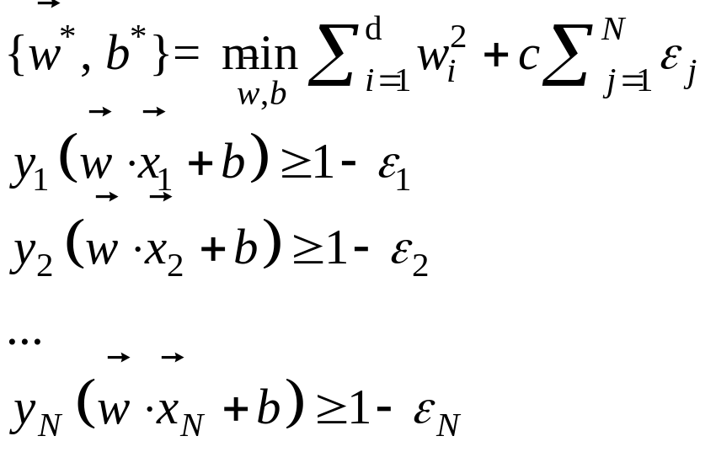



Support Vector Machine (SVM) for Noisy Data
denotes +1
denotes -1
Any problem with the above formulism?

Slide 30
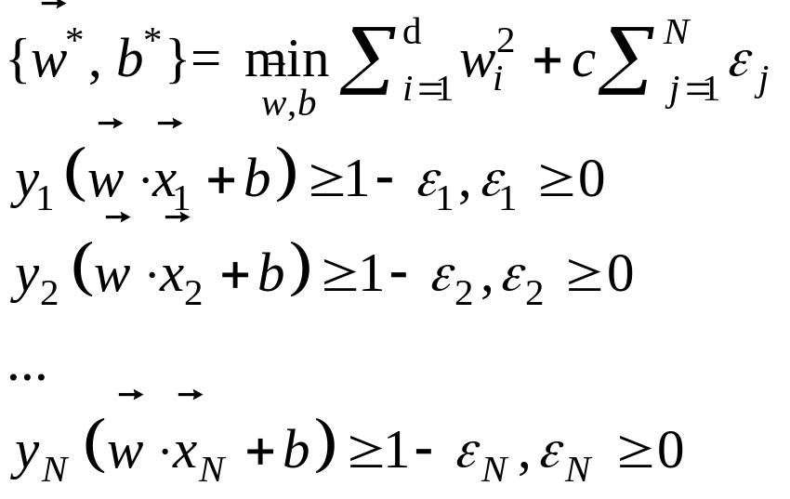
Support Vector Machine (SVM) for Noisy Data
denotes +1
denotes -1
Balance the trade off between margin and classification errors

Slide 31
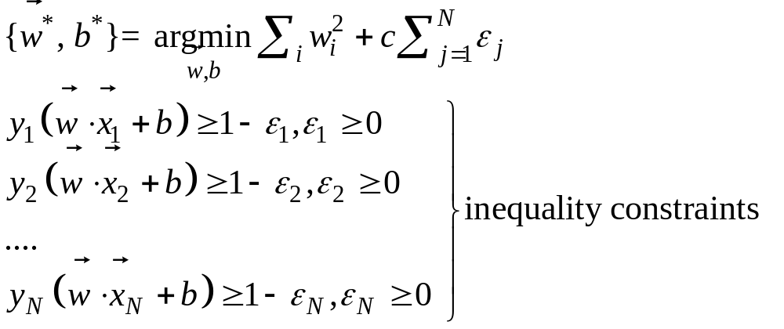
Support Vector Machine for Noisy Data
How do we determine the appropriate value for c ?

Slide 32
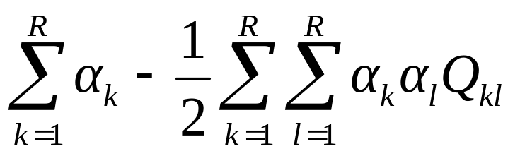
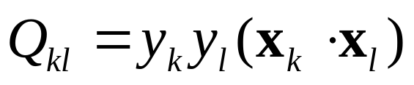
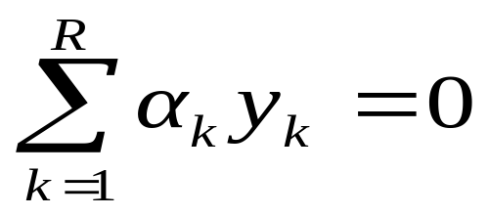
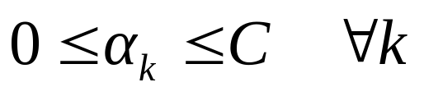
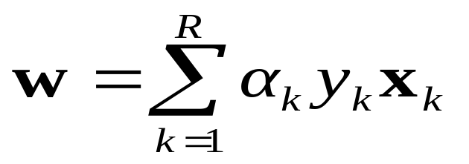
The Dual Form of QP
Maximize
where
Subject to these constraints:
Then define:
Then classify with:
f(x,w,b) = sign(w. x - b)

Slide 33
The Dual Form of QP
Maximize
where
Subject to these constraints:
Then define:

Slide 34
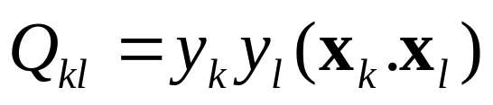
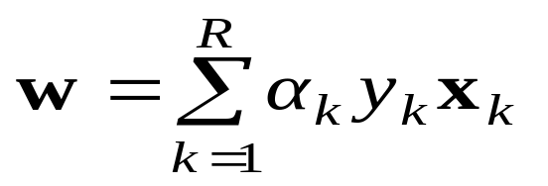
An Equivalent QP
Maximize
where
Subject to these constraints:
Then define:
Datapoints with α_{k} > 0 will be the support vectors
..so this sum only needs to be over the support vectors.

Slide 35
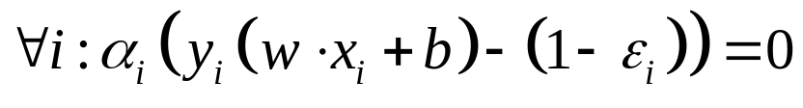




Support Vectors
Support Vectors
denotes +1
denotes -1
α_{i} = 0 for non-support vectors
α_{i} ≠ 0 for support vectors
Decision boundary is determined only by those support vectors !

Slide 36
The Dual Form of QP
Maximize
where
Subject to these constraints:
Then define:
Then classify with:
f(x,w,b) = sign(w. x - b)
How to determine b ?

Slide 37
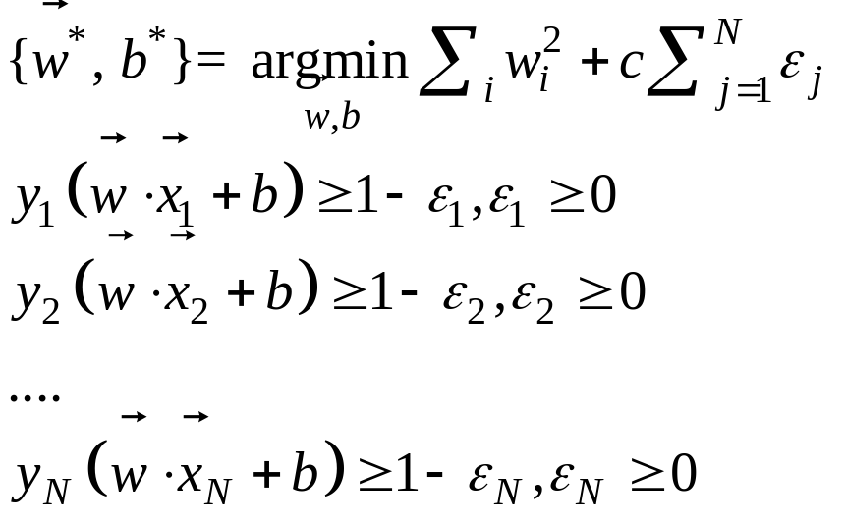
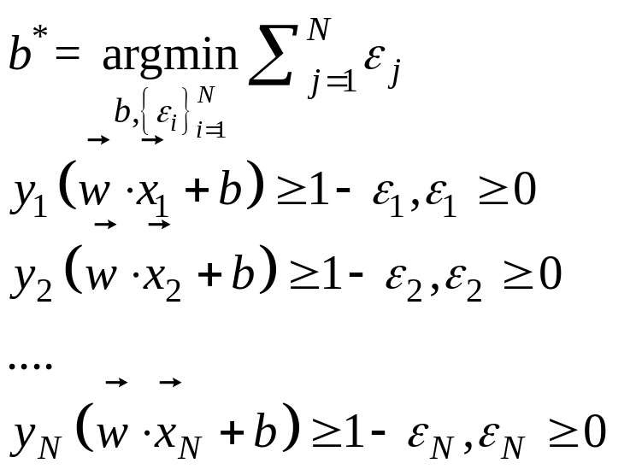
An Equivalent QP: Determine b
Fix w
A linear programming problem !

Slide 38
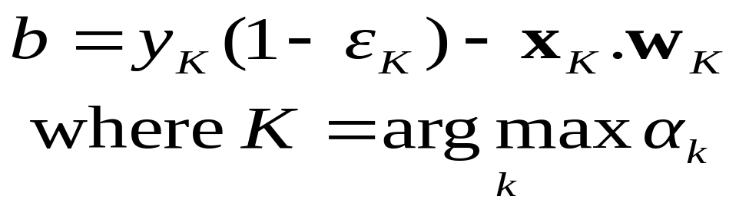
An Equivalent QP
Why did I tell you about this equivalent QP?
It’s a formulation that QP packages can optimize more quickly
Because of further jaw-dropping developments you’re about to learn.
Maximize
where
Subject to these constraints:
Then define:
Datapoints with α_{k} > 0 will be the support vectors
Then classify with:
f(x,w,b) = sign(w. x - b)
..so this sum only needs to be over the support vectors.

Slide 39
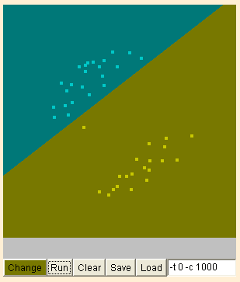
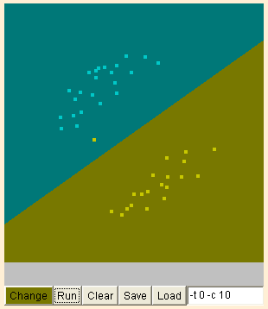
Online Demo
Parameter c is used to control the fitness
Noise

Slide 40
Roadmap
Hard-Margin Linear Classifier (Clean Data)
  Maximize Margin
  Support Vector
  Quadratic Programming
Soft-Margin Linear Classifier (Noisy Data)
  Maximize Margin
  Support Vector
  Quadratic Programming
Non-Linear Separable Problem
  XOR
Transform to Non-Linear by Kernels
Reference

Slide 41

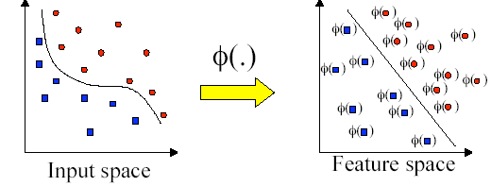
Feature Transformation ?
The problem is non-linear
Find some trick to transform the input
Linear separable after Feature Transformation
What Features should we use ?
Basic Idea :
XOR Problem

Slide 42
Suppose we’re in 1-dimension
What would SVMs do with this data?
x=0

Slide 43
Suppose we’re in 1-dimension
Not a big surprise
x=0
Positive “plane”
Negative “plane”

Slide 44
Harder 1-dimensional dataset
That’s wiped the smirk off SVM’s face.
What can be done about this?
x=0

Slide 45
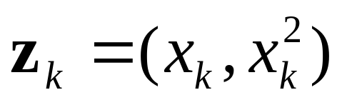
Harder 1-dimensional dataset
Map the data
from low-dimensional space
to high-dimensional space
Let’s permit them here too
x=0

Slide 46

Harder 1-dimensional dataset
Map the data
from low-dimensional space
to high-dimensional space
Let’s permit them here too
x=0
Feature Enumeration

Slide 47

Non-linear SVMs: Feature spaces
General idea: the original input space can always be mapped to some higher-dimensional feature space where the training set is separable:
Φ: x → φ(x)

Slide 48
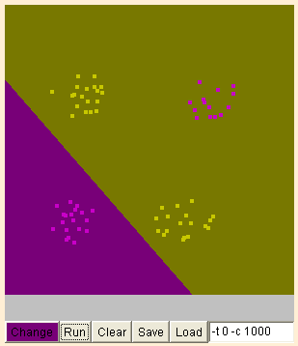
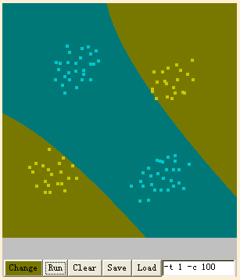
Online Demo
Polynomial features for the XOR problem

Slide 49
Online Demo
But……Is it the best margin Intuitively?

Slide 50
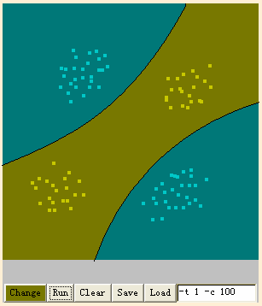
Online Demo
Why not something like this ?

Slide 51
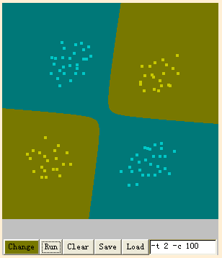
Online Demo
Or something like this ? Could We ?
  A More Symmetric Boundary

Slide 52
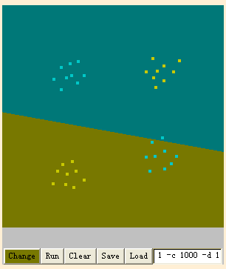
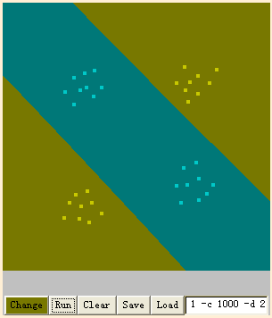
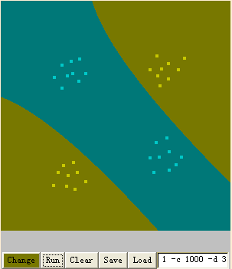
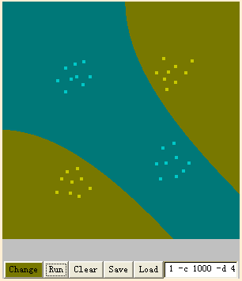
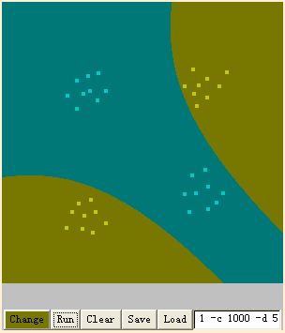
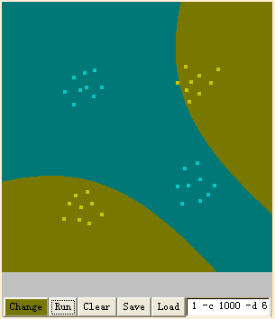
Degree of Polynomial Features
X^1
X^2
X^3
X^4
X^5
X^6

Slide 53
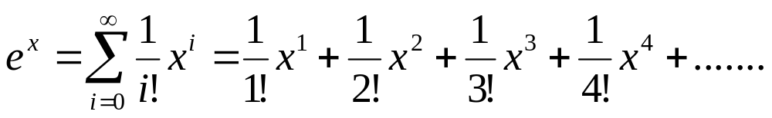
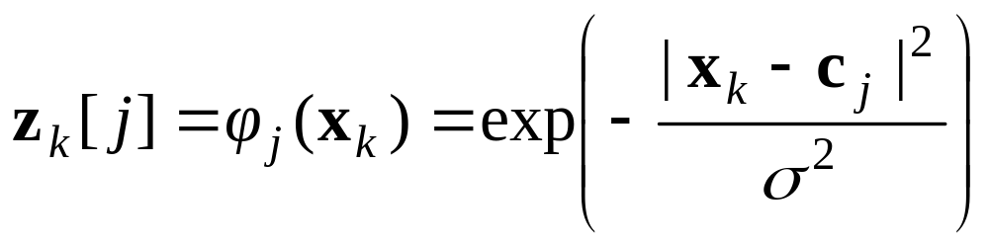
Towards Infinite Dimensions of Features
Enuermate polynomial features of all degrees ?
Taylor Expension of exponential function
zk = ( radial basis functions of xk )

Slide 54
Online Demo
“Radius basis functions” for the XOR problem

Slide 55
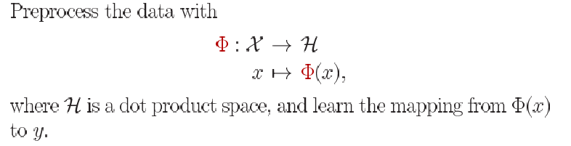

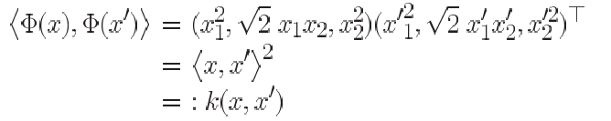
Efficiency Problem in Computing Feature
Feature space Mapping
This use of kernel function to avoid carrying out Φ(x) explicitly is known as the kernel trick
Example: all 2 degree Monomials
9 Multipllication
kernel trick
3 Multipllication

Slide 56
Common SVM basis functions
z_{k} = ( polynomial terms of x_{k} of degree 1 to q )
z_{k} = ( radial basis functions of x_{k} )
z_{k} = ( sigmoid functions of x_{k} )

Slide 57
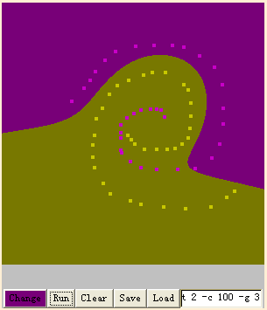




Online Demo
“Radius Basis Function” (Gaussian Kernel) Could solve complicated Non-Linear Problems
γ and c control the complexity of decision boundary

Slide 58





How to Control the Complexity
Which reasoning below is the most probable?
Bob got up and found that breakfast was ready
  Level-1 His Child (Underfitting)
  Level-2 His Wife (Reasonble) ☺
  Level-3 The Alien (Overfitting)

Slide 59

How to Control the Complexity
SVM is powerful to approximate any training data
The complexity affects the performance on new data
SVM supports parameters for controlling the complexity
SVM does not tell you how to set these parameters
Determine the Parameters by Cross-Validation
Underfitting
Overfitting
complexity

Slide 60

General Condition for Predictivity in Learning Theory
Tomaso Poggio, Ryan Rifkin, Sayan Mukherjee and Partha Niyogi. General Condition for Predictivity in Learning Theory. Nature. Vol 428, March, 2004.

Slide 61
Recall The MDL principle……
MDL stands for minimum description length
The description length is defined as:
Space required to described a theory
+
Space required to described the theory’s mistakes
In our case the theory is the classifier and the mistakes are the errors on the training data
Aim: we want a classifier with minimal DL
MDL principle is a model selection criterion

Slide 62
Support Vector Machine (SVM) for Noisy Data
denotes +1
denotes -1
Balance the trade off between margin and classification errors
Describe the Theory
Describe the Mistake

Slide 63
SVM Performance
Anecdotally they work very very well indeed.
Example: They are currently the best-known classifier on a well-studied hand-written-character recognition benchmark
Another Example: Andrew knows several reliable people doing practical real-world work who claim that SVMs have saved them when their other favorite classifiers did poorly.
There is a lot of excitement and religious fervor about SVMs as of 2001.
Despite this, some practitioners are a little skeptical.

Slide 64
References
An excellent tutorial on VC-dimension and Support Vector Machines:
    C.J.C. Burges. A tutorial on support vector machines for pattern recognition. Data Mining and Knowledge Discovery, 2(2):955-974, 1998. http://citeseer.nj.nec.com/burges98tutorial.html
The VC/SRM/SVM Bible: (Not for beginners including myself)
    Statistical Learning Theory by Vladimir Vapnik, Wiley-Interscience; 1998
Software: SVM-light, http://svmlight.joachims.org/, LibSVM, http://www.csie.ntu.edu.tw/~cjlin/libsvm/ SMO in Weka

Slide 65
Support Vector Regression

Slide 66
Roadmap
Squared-Loss Linear Regression
  Little Noise
  Large Noise
Linear-Loss Function
Support Vector Regression

Slide 67
Linear Regression
α
x
f
y^{est}
f(x,w,b) = w. x - b
How would you fit this data?

Slide 68
Linear Regression
α
x
f
y^{est}
f(x,w,b) = w. x - b
How would you fit this data?

Slide 69
Linear Regression
α
x
f
y^{est}
f(x,w,b) = w. x - b
How would you fit this data?

Slide 70
Linear Regression
α
x
f
y^{est}
f(x,w,b) = w. x - b
How would you fit this data?

Slide 71
Linear Regression
α
x
f
y^{est}
f(x,w,b) = w. x - b
Any of these would be fine..
..but which is best?

Slide 72
Linear Regression
α
x
f
y^{est}
f(x,w,b) = w. x - b
How to define the fitting error of a linear regression ?

Slide 73

Linear Regression
α
x
f
y^{est}
f(x,w,b) = w. x - b
How to define the fitting error of a linear regression ?
Squared-Loss

Slide 74

Online Demo
http://www.math.csusb.edu/faculty/stanton/m262/regress/regress.html

Slide 75


Sensitive to Outliers
Outlier

Slide 76
Why ?
Squared-Loss Function
  Fitting Error Grows Quadratically

Slide 77

How about Linear-Loss ?
Linear-Loss Function
  Fitting Error Grows Linearly

Slide 78
Actually
SVR uses the Loss Function below
ε-insensitive loss function
−ε
ε

Slide 79


Epsilon Support Vector Regression (ε-SVR)
Given: a data set {x₁, ..., x_{n}} with target values {u₁, ..., u_{n}}, we want to do ε-SVR
The optimization problem is
Similar to SVM, this can be solved as a quadratic programming problem

Slide 80


Online Demo
Less Sensitive to Outlier

Slide 81


Again, Extend to Non-Linear Case
Similar with SVM

Slide 82
What We Learn
Linear Classifier with Clean Data
Linear Classifier with Noisy Data
SVM for Noisy and Non-Linear Data
Linear Regression with Clean Data
Linear Regression with Noisy Data
SVR for Noisy and Non-Linear Data
General Condition for Predictivity in Learning Theory

Slide 83
The End

Slide 84


Saddle Point

